Slide 1
Linear Block Code
Prepared by
Prof. Hitesh Dholakiya
Modified by
Rifat Rahman
Assistant Professor
Institute of Appropriate Technology, BUET

Slide 2
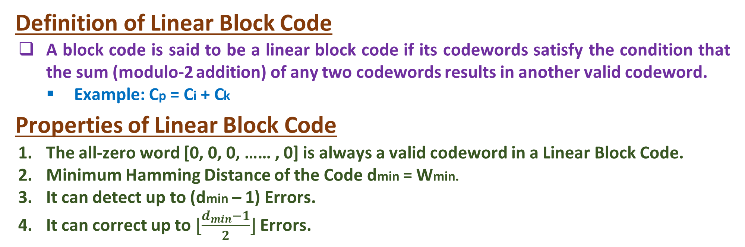
Linear Block Code
Definition of Linear Block Code
A block code is said to be a linear block code if its codewords satisfy the condition that the sum (modulo-2 addition) of any two codewords results in another valid codeword.
Example: Cp = Ci + Ck
Properties of Linear Block Code
The all-zero word [0, 0, 0, …… , 0] is always a valid codeword in a Linear Block Code.
Minimum Hamming Distance of the Code dmin = Wmin.
It can detect up to (dmin – 1) Errors.
It can correct up to$⌊\frac{d_{min}−1}{2}⌋$Errors.

Slide 3
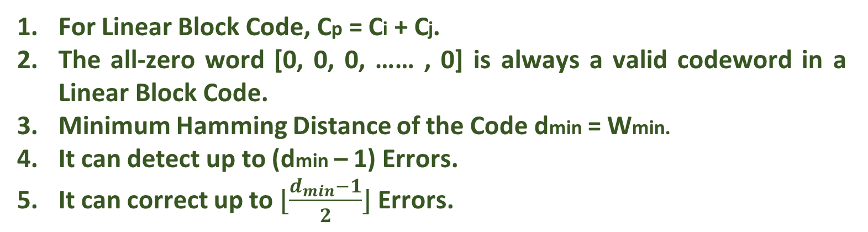
Checking whether Hamming Code is a Linear Block Code
Hamming Code (7,4)
D4 | D3 | D2 | P3 | D1 | P2 | P1
0 | 0 | 0 | 0 | 0 | 0 | 0
0 | 0 | 0 | 0 | 1 | 1 | 1
0 | 0 | 1 | 1 | 0 | 0 | 1
0 | 0 | 1 | 1 | 1 | 1 | 0
0 | 1 | 0 | 1 | 0 | 1 | 0
0 | 1 | 0 | 1 | 1 | 0 | 1
0 | 1 | 1 | 0 | 0 | 1 | 1
0 | 1 | 1 | 0 | 1 | 0 | 0
1 | 0 | 0 | 1 | 0 | 1 | 1
1 | 0 | 0 | 1 | 1 | 0 | 0
1 | 0 | 1 | 0 | 0 | 1 | 0
1 | 0 | 1 | 0 | 1 | 0 | 1
1 | 1 | 0 | 0 | 0 | 0 | 1
1 | 1 | 0 | 0 | 1 | 1 | 0
1 | 1 | 1 | 1 | 0 | 0 | 0
1 | 1 | 1 | 1 | 1 | 1 | 1
For Linear Block Code, Cp = Ci + Cj.
The all-zero word [0, 0, 0, …… , 0] is always a valid codeword in a Linear Block Code.
Minimum Hamming Distance of the Code dmin = Wmin.
It can detect up to (dmin – 1) Errors.
It can correct up to $⌊\frac{d_{min}−1}{2}⌋$ Errors.

Slide 4
Example of Linear Block Code
Example 1: Show that the (4, 3) Even-Parity Code is linear and the (4, 3) Odd-Parity Code is not linear.
(4, 3) Even Parity Block Code (4, 3) Odd Parity Block Code
Data |  |  | Parity
D3 | D2 | D1 | P
0 | 0 | 0 | 0
0 | 0 | 1 | 1
0 | 1 | 0 | 1
0 | 1 | 1 | 0
1 | 0 | 0 | 1
1 | 0 | 1 | 0
1 | 1 | 0 | 0
1 | 1 | 1 | 1
Data |  |  | Parity
D3 | D2 | D1 | P
0 | 0 | 0 | 1
0 | 0 | 1 | 0
0 | 1 | 0 | 0
0 | 1 | 1 | 1
1 | 0 | 0 | 0
1 | 0 | 1 | 1
1 | 1 | 0 | 1
1 | 1 | 1 | 0
Cp = Ci + Ck, It is followed in (4, 3) Even Parity Block Code, but it is not followed in (4, 3) Odd Parity Block Code.

Slide 5
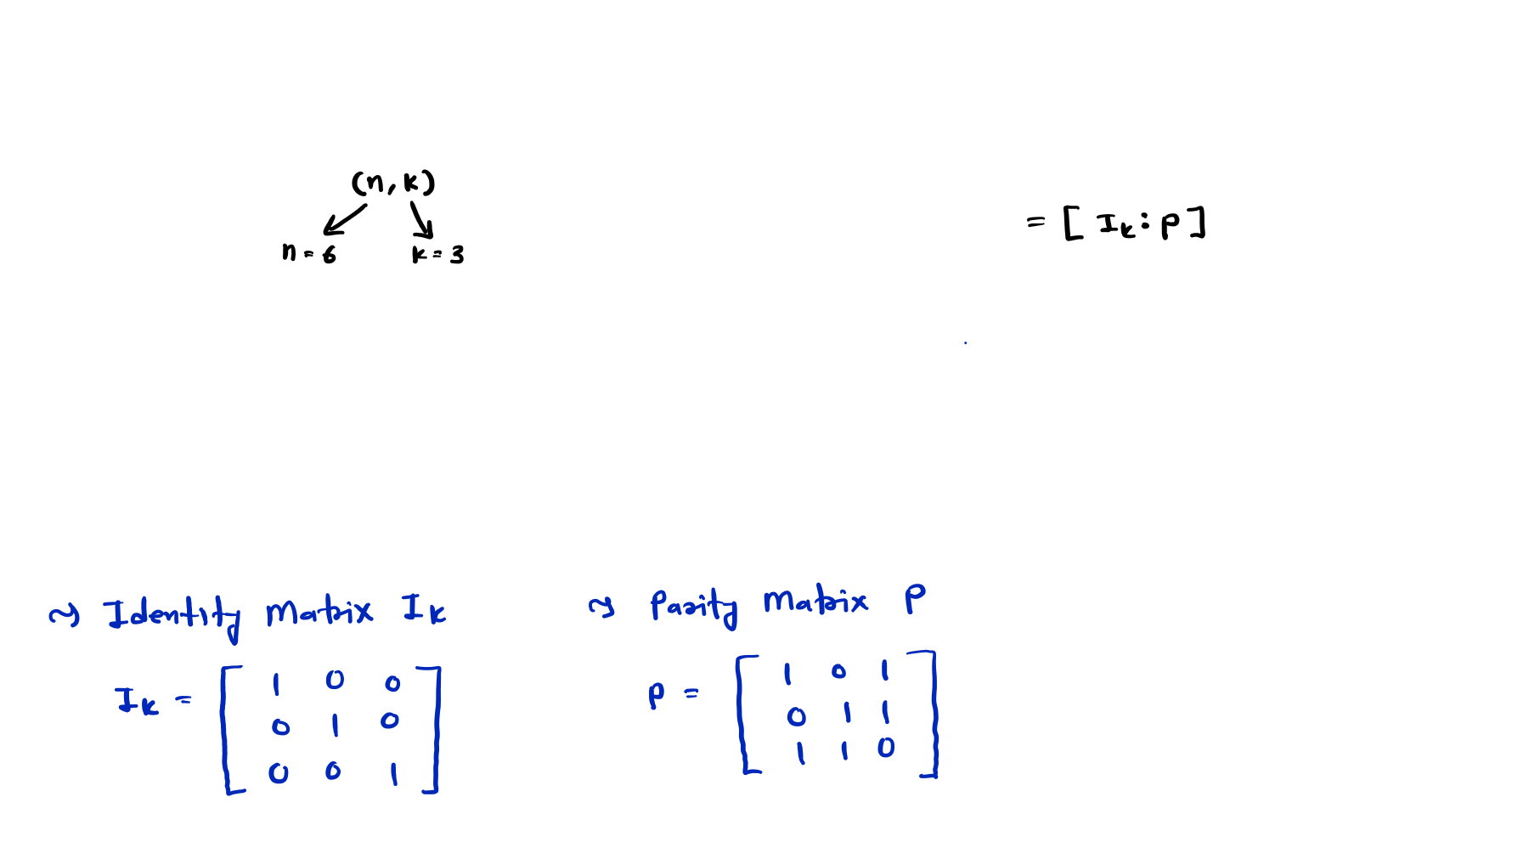
Linear Block Code Solved Example
Example 1: For a (6, 3) code, the Generator Matrix G is given by:
 |  | 𝟏 | 𝟎 | 𝟎 | 𝟏 | 𝟎 | 𝟏
 | ⟹ 𝐆 = | 𝟎 | 𝟏 | 𝟎 | 𝟎 | 𝟏 | 𝟏
Find, |  | 𝟎 | 𝟎 | 𝟏 | 𝟏 | 𝟏 | 𝟎
❑
All Corresponding Code Vectors
Minimum Hamming Distance
Error Detection and Error Correction Capability
Parity Check Matrix
Find error if received code is [1 0 0 0 1 1]

Slide 6
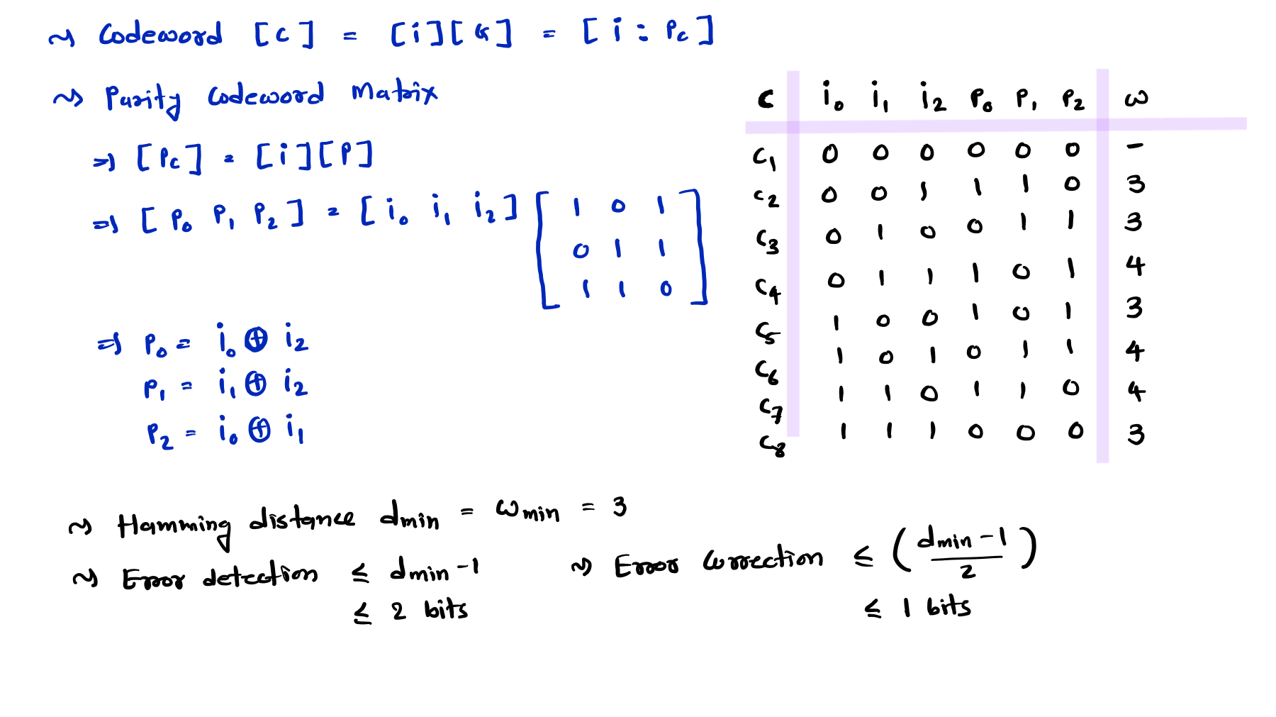
Minimum Hamming Distance

Slide 7
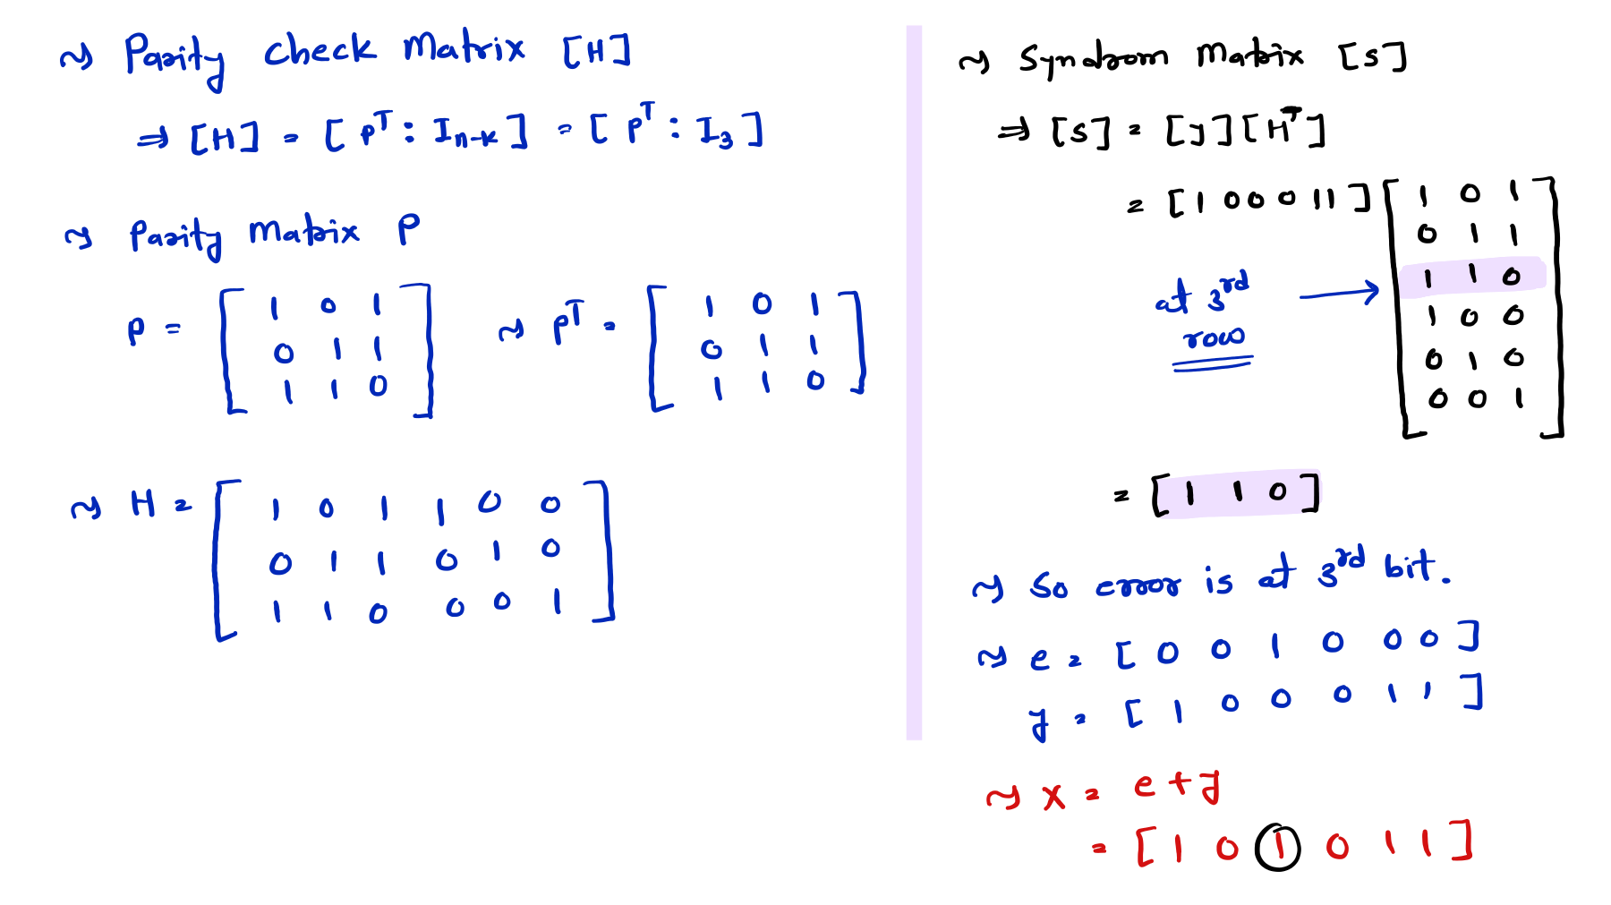

Slide 8
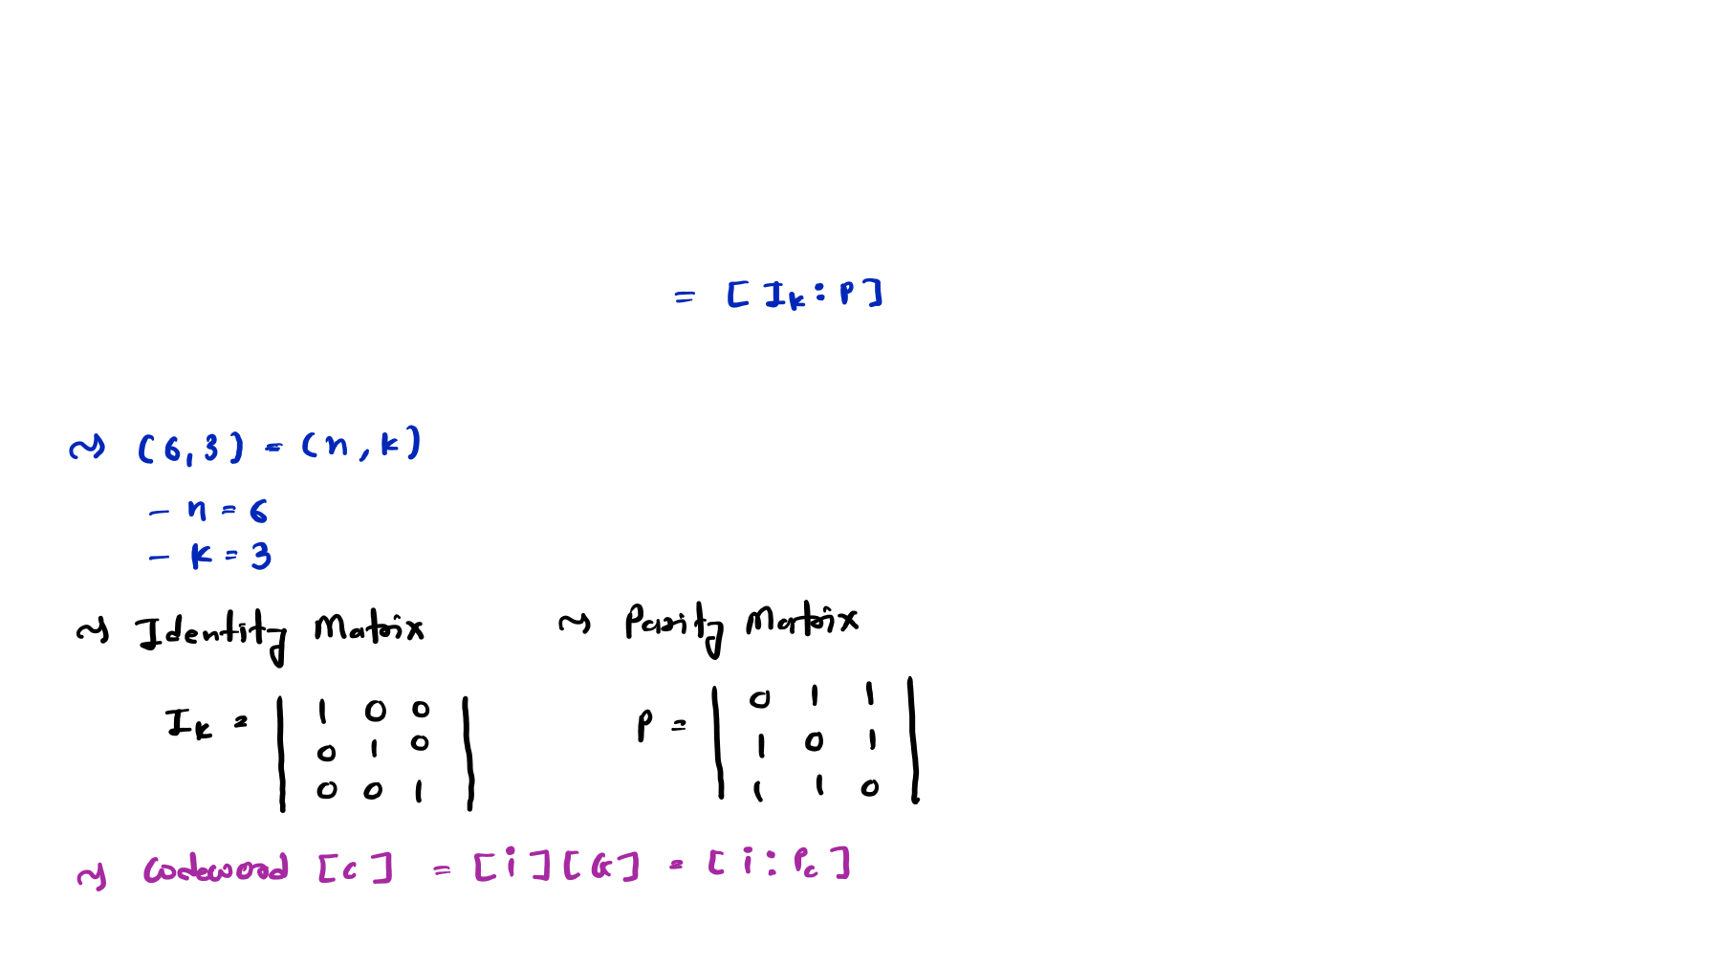
Linear Block Code Solved Examples
Example 2: Determine the set of codewords for a (6, 3) code, the Generator Matrix G is given by:
 | 𝟏 | 𝟎 | 𝟎 | 𝟎 | 𝟏 | 𝟏
⟹ 𝐆 = | 𝟎 | 𝟏 | 𝟎 | 𝟏 | 𝟎 | 𝟏
 | 𝟎 | 𝟎 | 𝟏 | 𝟏 | 𝟏 | 𝟎

Slide 9
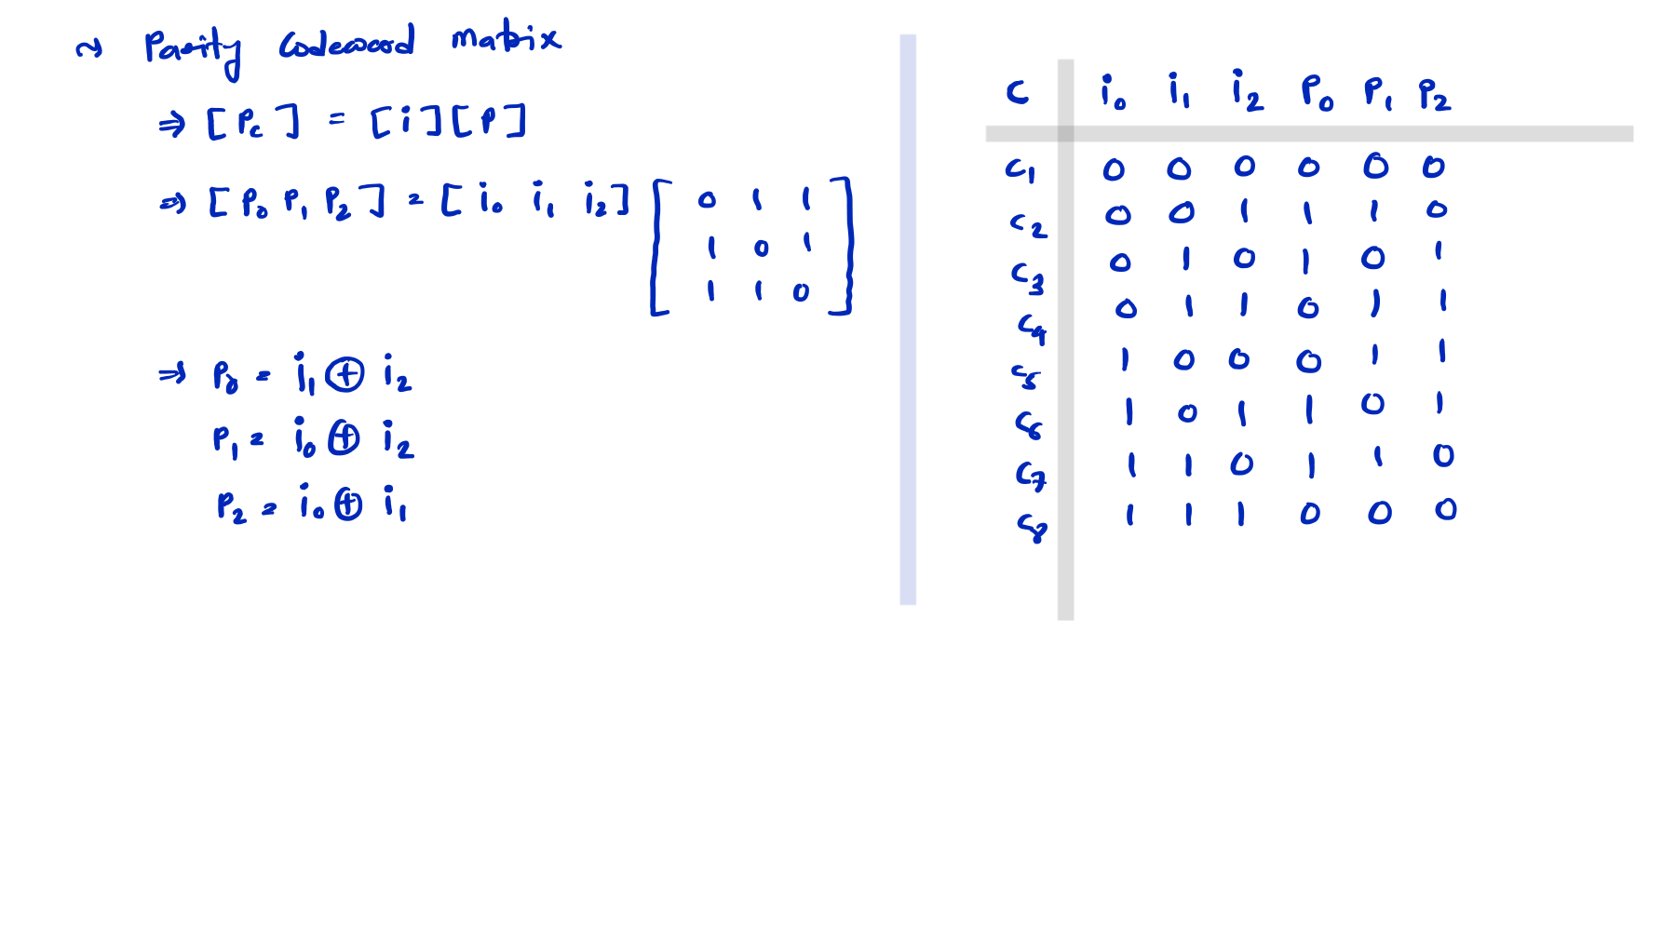

Slide 10
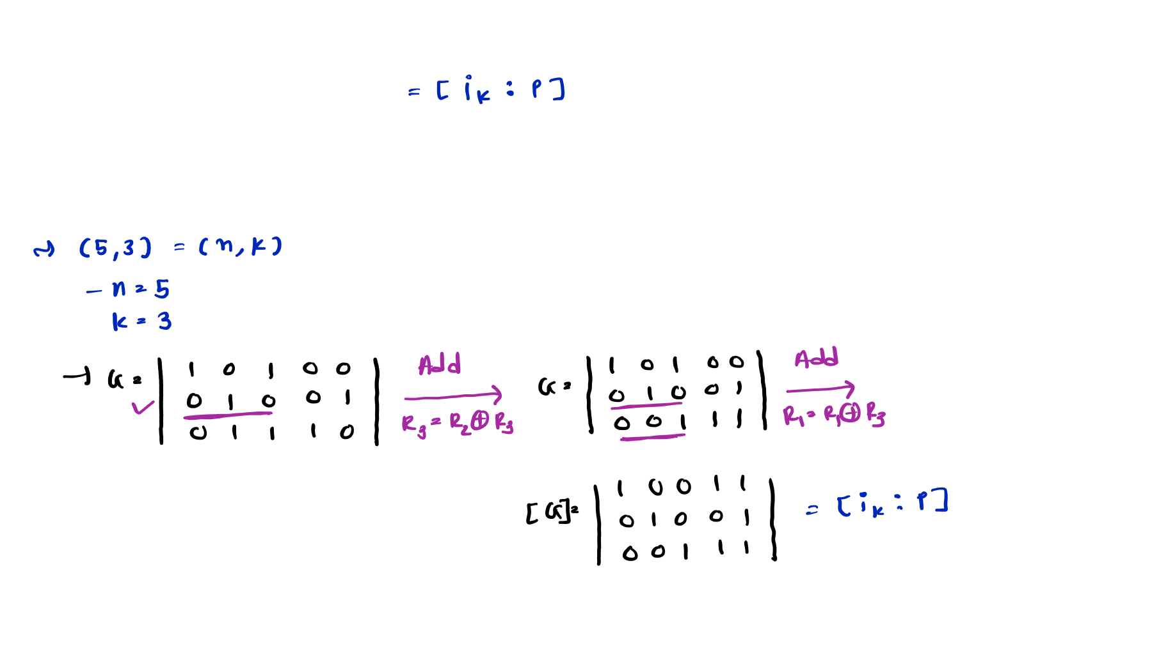
Example 3: The (5, 3) linear code has the generator Matrix G:
𝟏 𝟎 𝟏 𝟎 𝟎
𝟎 𝟏 𝟎 𝟎 𝟏
⟹ 𝐆 =
𝟎 𝟏 𝟏 𝟏 𝟎
Determine Systematic form of G.
Generate Codeword for information [0 1 1] with systematic G and Non-systematic G.

Slide 11
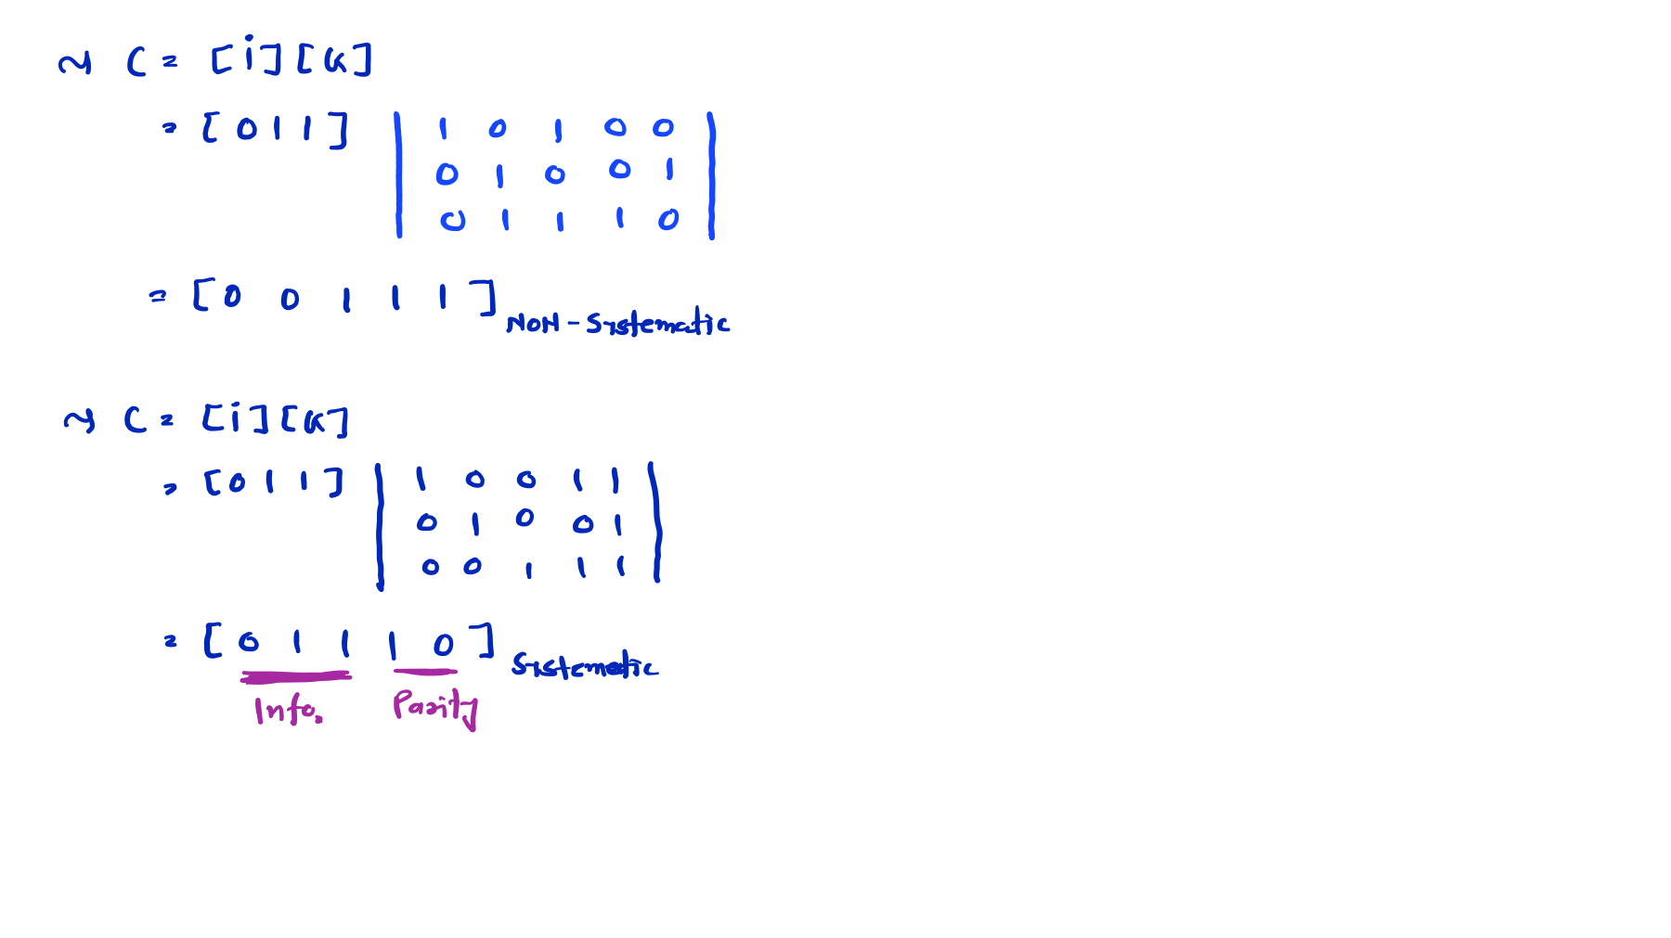

Slide 12
Elementary Row Operations (ERO)
Elementary row operations are the three fundamental transformations we can apply to generator matrices without changing the fundamental properties of the code they represent.
Three Types of Operations:
Row Swapping (Type I): Exchanging two rows
Symbol: Ri​↔Rj​
Effect: Reorders the basis vectors of the code
2. Row Scaling (Type II): Multiplying a row by a non-zero scalar
Symbol: Ri→αRi; where α≠0
Effect: Changes the representation but not the code itself
3. Row Addition (Type III): Adding a multiple of one row to another
Symbol: Ri→Ri+αRj
​Effect: Transforms the basis while preserving the code

Slide 13
Conversion to Systematic Generator Matrix
In coding theory, transforming a generator matrix through elementary row operations and column swaps has specific impacts on the resulting linear code
Impact of Elementary Row Operations (EROs)
Preserves the Code: EROs do not change the code itself. The set of all possible codewords remains exactly the same because the rows still span the same vector space.
Changes the Basis: It simply provides a different "basis" for the code.
Distance/Weight Properties: The minimum distance (dmin) and weight distribution of the code are completely unaffected.
Encoding Logic: While the code is the same, the mapping between message bits and codewords changes.

Slide 14
Conversion to Systematic Generator Matrix
Impact of Column Swaps
Creates an Equivalent Code: Column swaps do not preserve the exact code; instead, they create a permutationally equivalent code.
Changes the Codewords: The individual codewords change because the positions of the bits are rearranged.
Preserves Fundamental Properties: Even though the codewords look different, the "quality" of the code remains the same:
-The minimum distance (dmin) remains unchanged.
-The error-correcting capability remains identical.
-The weight enumerator (how many words have how many 1s) stays the same.
4. Hardware/Software Impact: Swapping columns requires you to keep track of the new bit order so that the receiver can "un-swap" them to retrieve the original message.

Slide 15
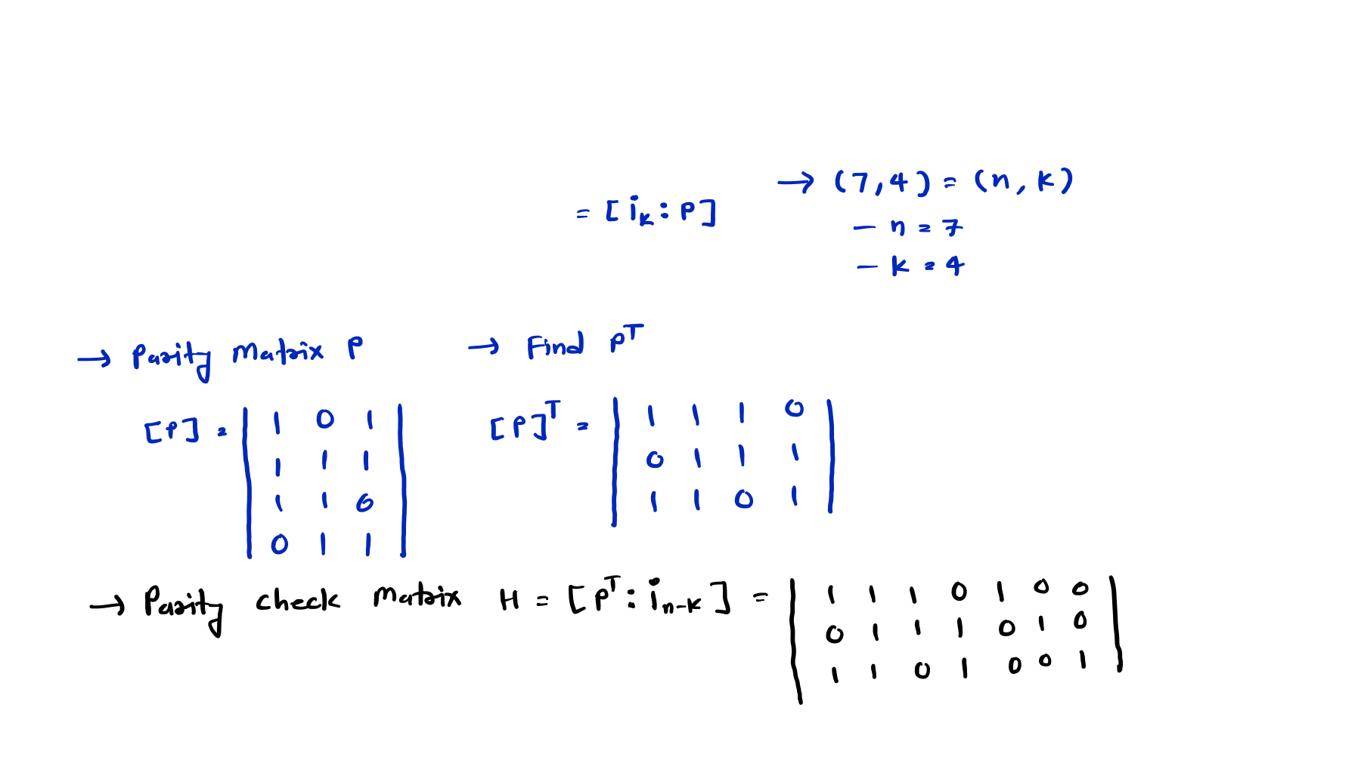
Linear Block Code Solved Examples
Example 4: Determine the parity check Matrix for (7, 4) Generator Matrix G:
⟹ 𝐆 =
𝟏 | 𝟎 | 𝟎 | 𝟎 | 𝟏 | 𝟎 | 𝟏
𝟎 | 𝟏 | 𝟎 | 𝟎 | 𝟏 | 𝟏 | 𝟏
𝟎 | 𝟎 | 𝟏 | 𝟎 | 𝟏 | 𝟏 | 𝟎
𝟎 | 𝟎 | 𝟎 | 𝟏 | 𝟎 | 𝟏 | 𝟏

Slide 16
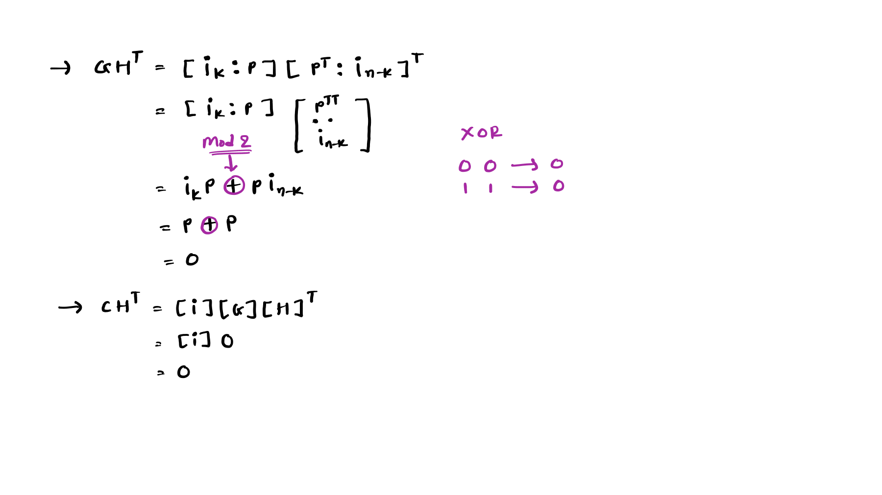
Example 5: Prove that 𝐆𝐇^{𝐓} and 𝐂𝐇^{𝐓} = 𝟎.

Slide 17
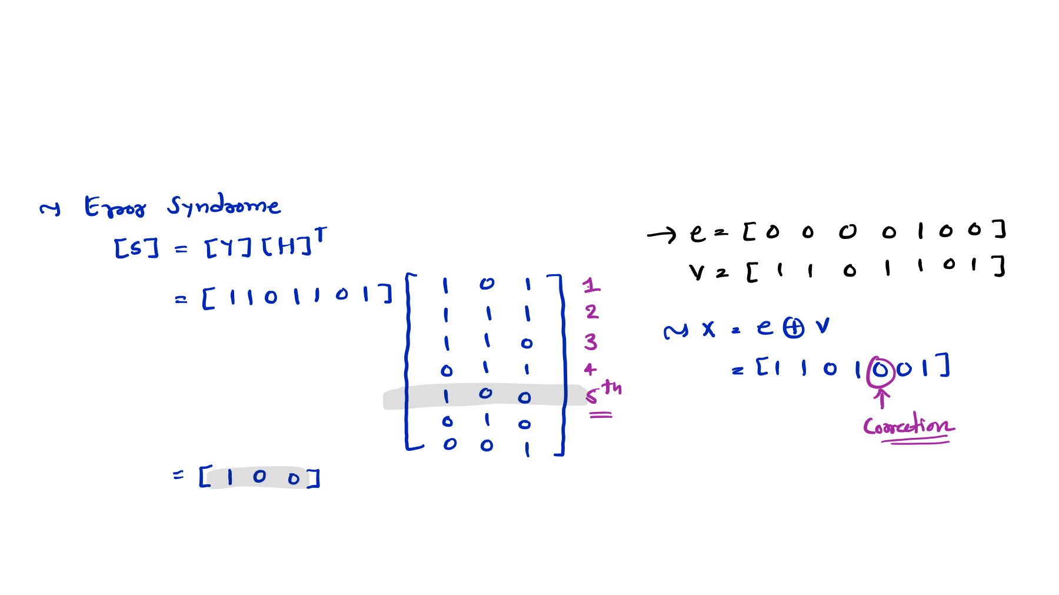
Example 6: Find the Error Syndrome of received codeword V = [1 1 0 1 1 0 1], Also correct the Error. Here Parity Check Matrix is given by:
 | 𝟏 | 𝟏 | 𝟏 | 𝟎 | 𝟏 | 𝟎 | 𝟎
⟹ 𝐇 = | 𝟎 | 𝟏 | 𝟏 | 𝟏 | 𝟎 | 𝟏 | 𝟎
 | 𝟏 | 𝟏 | 𝟎 | 𝟏 | 𝟎 | 𝟎 | 𝟏

Slide 18
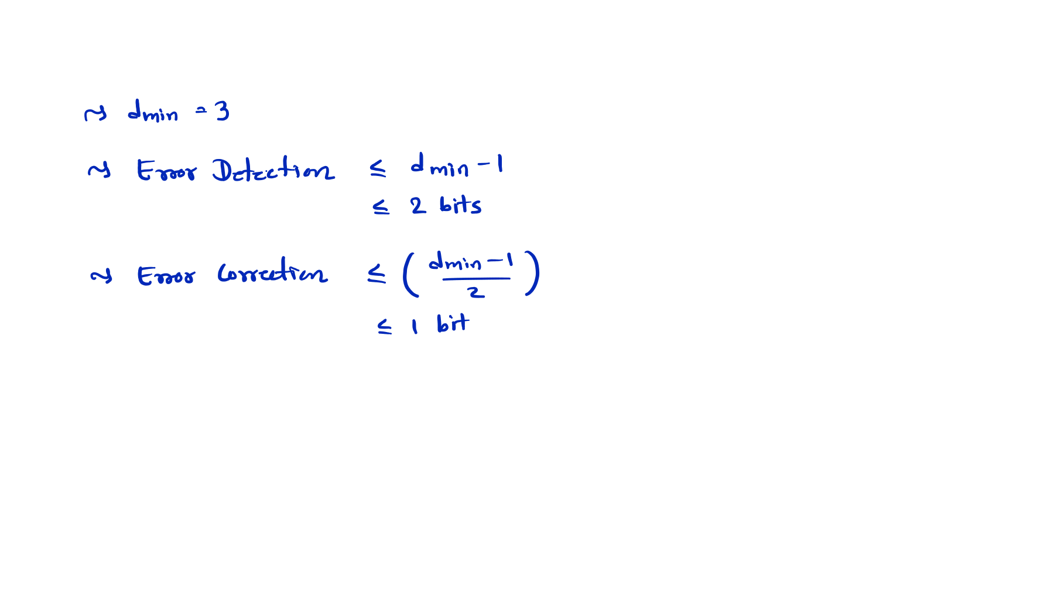
Example 7: If the minimum hamming distance of a linear block code is 3. Find Code error detection and error correction capability.

Slide 19
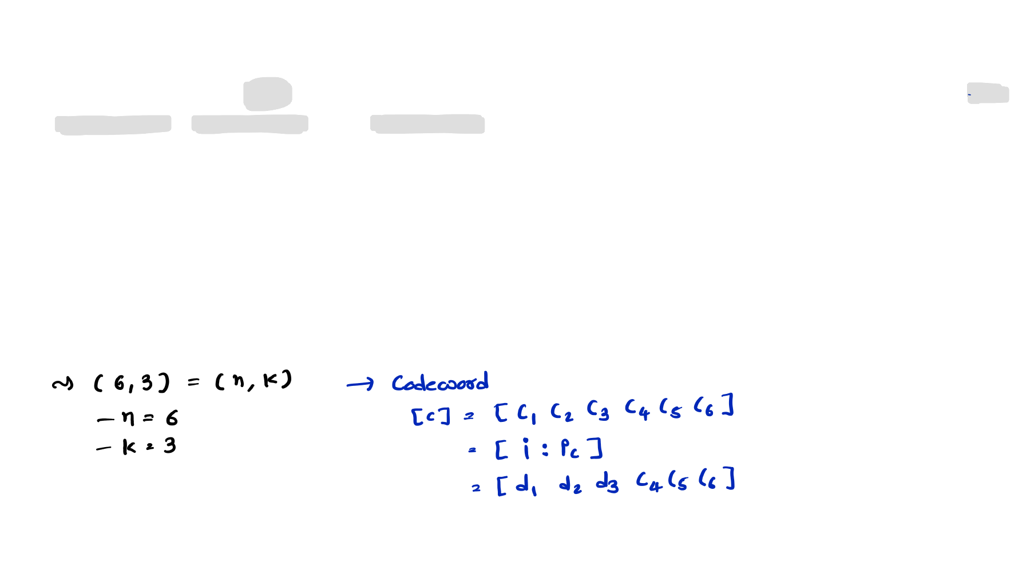
Linear Block Code Solved Example
Example 8: For a (6, 3) Systematic Linear Block code, the three parity check digits are C4 = d1 + d2 + d3, C5 = d1 + d2, and C6 = d1 + d3
Find,
All Corresponding Code Vectors
Minimum Hamming Distance
Error Detection and Error Correction Capability
Generator Matrix
Parity Check Matrix
Find error if received code is [1 0 1 1 0 0]

Slide 20
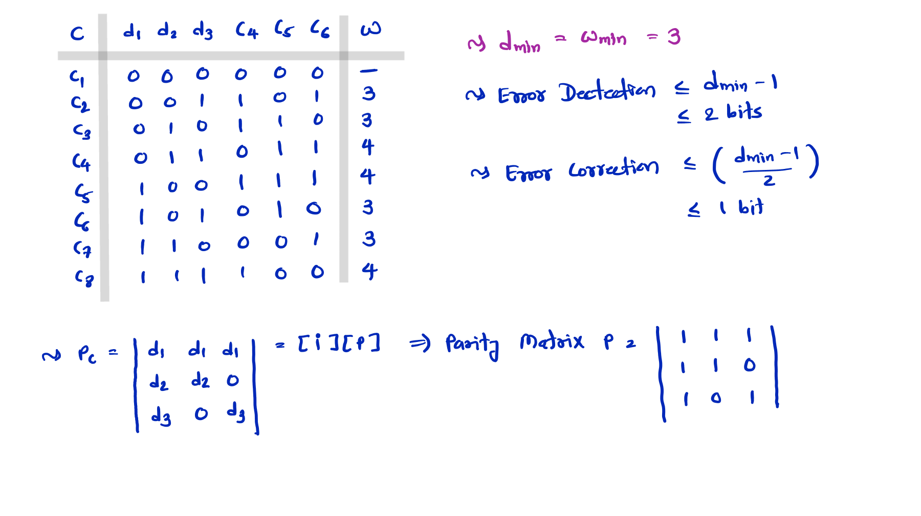

Slide 21
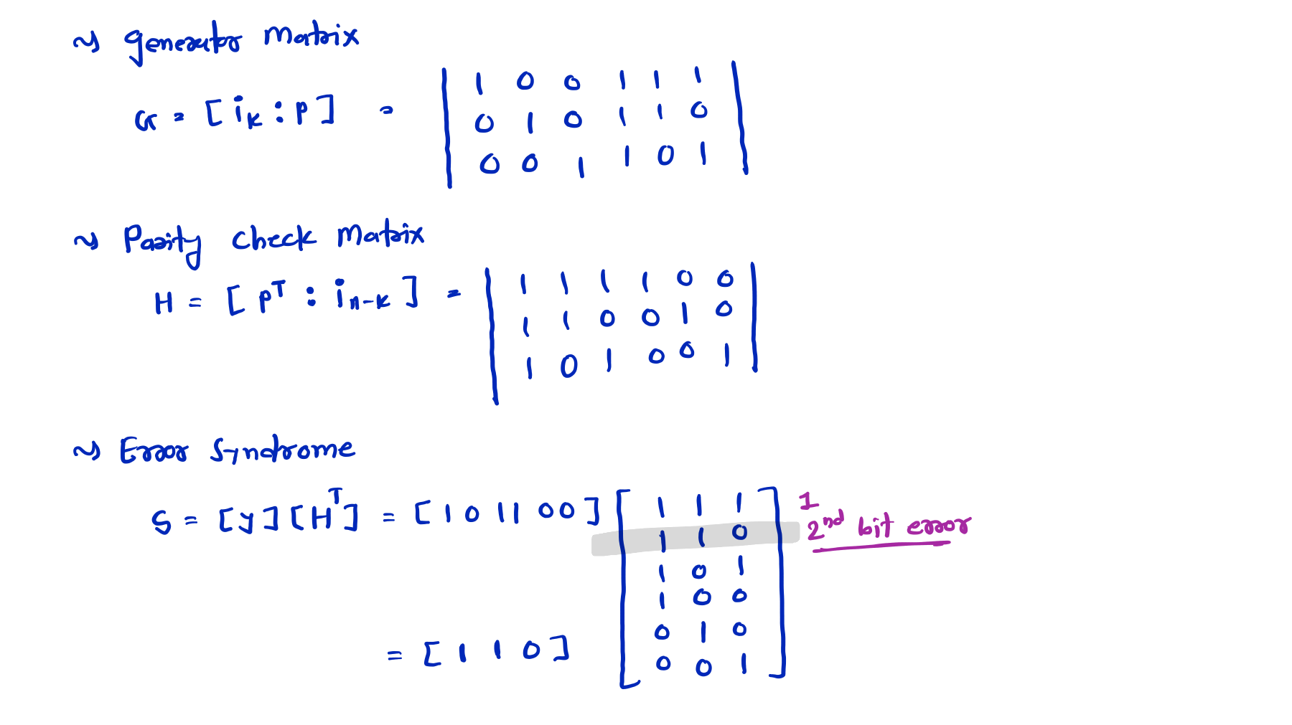

Slide 22
